Slide 1
ns-3 Training

Slide 2
Object metadata system
ns-3 is, at heart, a C++ object system
ns-3 objects that inherit from base class ns3::Object get several additional features
smart-pointer memory management (Class Ptr)
dynamic run-time object aggregation
an attribute system

Slide 3
Smart pointers
Smart pointers in ns-3 use reference counting to improve memory management
The class ns3::Ptr is semantically similar to a traditional pointer, but the object pointed to will be deleted when all references to the pointer are gone
ns-3 heap-allocated objects should use the templated Create<>() or CreateObject<> () methods

Slide 4
Examples
Ptr<WifiNetDevice> dev =
CreateObject<WifiNetDevice> ();
Ptr<Packet> pkt = Create<Packet> ();
(instead of Packet* = new Packet;)
why Create<> vs CreateObject<>?
two different base classes; generally use CreateObject<>(), but Create<> for Packet

Slide 5
Dynamic run-time object aggregation
This feature is similar to "Component Object Model (COM)"-- allows interfaces (objects) to be aggregated at run-time instead of at compile time
Useful for binding dissimilar objects together without adding pointers to each other in the classes

Slide 6
Usage
ns-3 Node protocol stacks are added via aggregation
The IP stack can be found from a Node pointer without class Node knowing about it
Energy models are typically aggregated to nodes
To find interfaces, use GetObject<>(); e.g.
Ptr<Ipv4> ipv4 = m_node->GetObject<Ipv4> ();

Slide 7
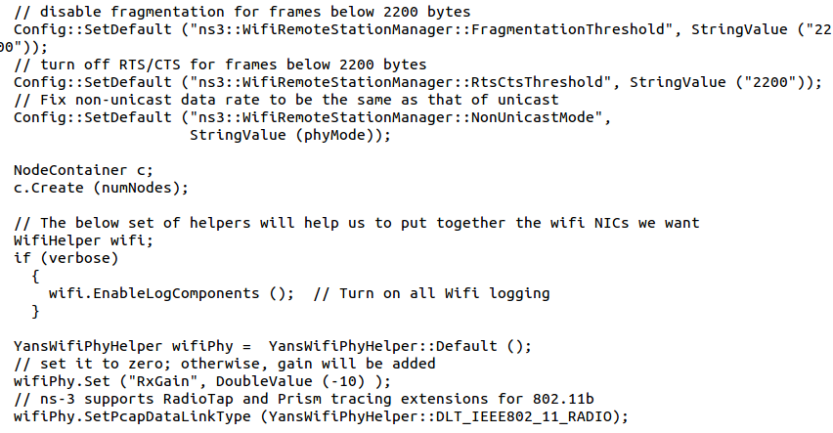
Attributes and default values

Slide 8
ns-3 attribute system
Problem: Researchers want to identify all of the values affecting the results of their simulations
and configure them easily
ns-3 solution: Each ns-3 object has a set of attributes:
A name, help text
A type
An initial value
Control all simulation parameters for static objects
Dump and read them all in configuration files
Visualize them in a GUI
Makes it easy to verify the parameters of a simulation

Slide 9
Short digression: Object metadata system
ns-3 is, at heart, a C++ object system
ns-3 objects that inherit from base class ns3::Object get several additional features
dynamic run-time object aggregation
an attribute system
smart-pointer memory management (Class Ptr)
We focus here on the attribute system

Slide 10
Use cases for attributes
An Attribute represents a value in our system
An Attribute can be connected to an underlying variable or function
e.g. TcpSocket::m_cwnd;
or a trace source

Slide 11
Use cases for attributes (cont.)‏
What would users like to do?
Know what are all the attributes that affect the simulation at run time
Set a default initial value for a variable
Set or get the current value of a variable
Initialize the value of a variable when a constructor is called
The attribute system is a unified way of handling these functions

Slide 12
How to handle attributes
The traditional C++ way:
export attributes as part of a class's public API
walk pointer chains (and iterators, when needed) to find what you need
use static variables for defaults
The attribute system provides a more convenient API to the user to do these things

Slide 13
Navigating the attributes
Attributes are exported into a string-based namespace, with filesystem-like paths
namespace supports regular expressions
Attributes also can be used without the paths
e.g. “ns3::WifiPhy::TxGain”
A Config class allows users to manipulate the attributes

Slide 14
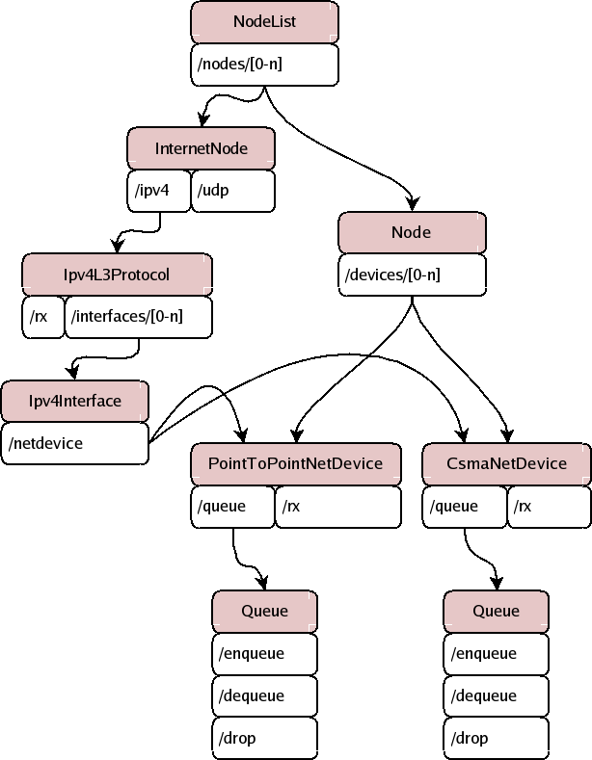
Attribute namespace
strings are used to describe paths through the namespace
Config::Set ("/NodeList/1/$ns3::Ns3NscStack<linux2.6.26>/net.ipv4.tcp_sack", StringValue ("0"));

Slide 15
Navigating the attributes using paths
Examples:
Nodes with NodeIds 1, 3, 4, 5, 8, 9, 10, 11:
“/NodeList/[3-5]|[8-11]|1”
UdpL4Protocol object instance aggregated to matching nodes:
“/$ns3::UdpL4Protocol”

Slide 16
What users will do
e.g.: Set a default initial value for a variable
Config::Set (“ns3::YansWifiPhy::TxGain”, DoubleValue (1.0));
Syntax also supports string values:
Config::Set (“YansWifiPhy::TxGain”, StringValue (“1.0”));
Attribute
Value

Slide 17
Fine-grained attribute handling
Set or get the current value of a variable
Here, one needs the path in the namespace to the right instance of the object
Config::SetAttribute(“/NodeList/5/DeviceList/3/$ns3::WifiNetDevice/Phy/$ns3::YansWifiPhy/TxGain”, DoubleValue(1.0));
DoubleValue d; nodePtr->GetAttribute ( “/NodeList/5/NetDevice/3/$ns3::WifiNetDevice/Phy/$ns3::YansWifiPhy/TxGain”, d);
Users can get Ptrs to instances also, and Ptrs to trace sources, in the same way

Slide 18
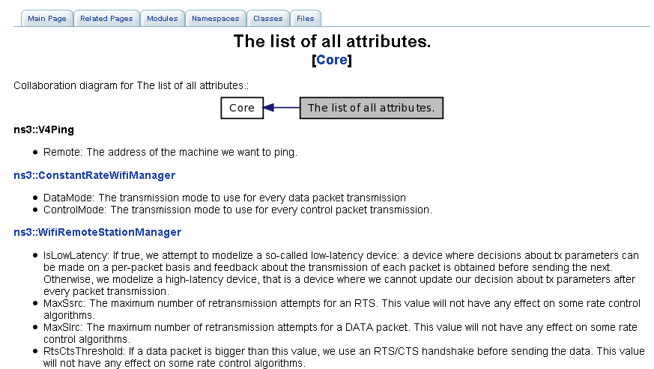
Attribute documentation

Slide 19
Options to manipulate attributes
Individual object attributes often derive from default values
Setting the default value will affect all subsequently created objects
Ability to configure attributes on a per-object basis
Set the default value of an attribute from the command-line:
CommandLine cmd;
cmd.Parse (argc, argv);
Set the default value of an attribute with NS_ATTRIBUTE_DEFAULT
Set the default value of an attribute in C++:
Config::SetDefault ("ns3::Ipv4L3Protocol::CalcChecksum",
BooleanValue (true));
Set an attribute directly on a specic object:
Ptr<CsmaChannel> csmaChannel = ...;
csmaChannel->SetAttribute ("DataRate",
StringValue ("5Mbps"));

Slide 20
Summary on ns-3 objects
ns-3 objects that inherit from base class ns3::Object get several additional features
smart-pointer memory management (Class Ptr)
dynamic run-time object aggregation
an attribute system
These types of objects are allocated on the heap, not on the stack

